Slide 1

NETWORKING
Presentation made by: Ms. Archika Bhatia

Slide 2
TRANSMISSION MEDIA
Transmission media enable computers to send and receive messages.
Computers can communicate through cables, light, and radio waves.(via Guided/Unguided media)
Let us learn about three basic types of cables used:
  Twisted pair Cable
  Coaxial Cable
  Optical Fibre

Slide 3
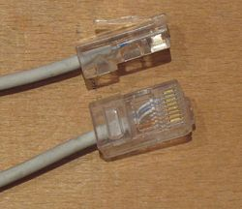
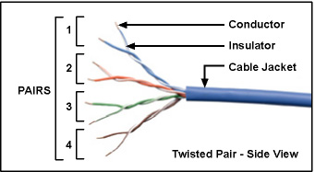
TWISTED PAIR CABLE
It consists of two identical wires wrapped together.
Advantage
Simplicity and ease of installation.
Low cost
Disadvantage
Data transmission characteristics are not so good.
The 8 pin modular jacks at both ends of an Ethernet cable, clearly showing the wire pairs inside.

Slide 4
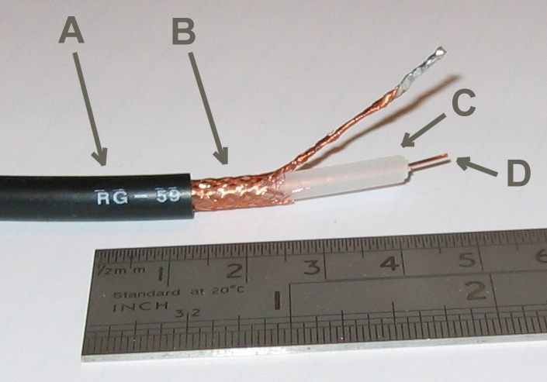
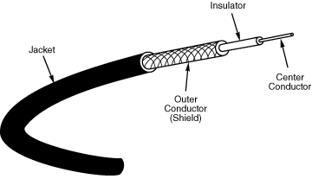
COAXIAL CABLE
The structure of coaxial cable consists of four main components as shown in the picture below.
Another ex: Cable coaxial RG-59.
A: Plastic Jacket
B: Metallic Core
C: Dialetric Insulator
D: Center Core
Data transmission characteristics are much better than twisted pair cable. And cost is more than TPC.

Slide 5

OPTICAL FIBRE
It consists of thin strands of glass or glass like material to transmit data modulated onto light waves.
They carry light from a source at one end of the fiber to a detector at the other end.
Advantage
Capable of carrying more data.
Less susceptible to interference from outside world.
Much thinner.
Data can be transmitted digitally rather than analogically.
Disadvantage
Expensive to install.
Very fragile.

Slide 6
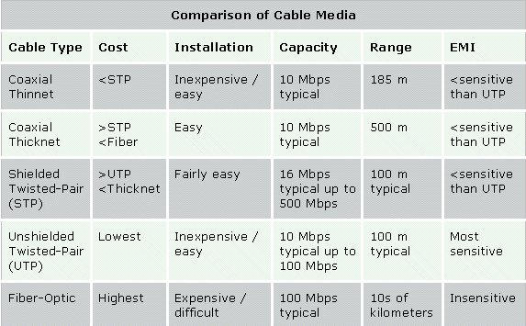
EMI is Electromagnetic Interference: It consists of outside electromagnetic noise that distorts the signal in a medium. When you listen to an AM radio, for example, you often hear EMI in the form of noise caused by nearby motors or lightning.
Attenuation: is a measure of how much a signal weakens as it travels through a medium. Attenuation is a contributing factor to why cable designs must specify limits in the lengths of cable runs.

Slide 7
WIRELESS COMMUNICATION MEDIA:
(Unguided Media)
RADIO FREQUENCY PROPOGATION
MICROWAVE LINK
SATELLITE
INFRARED

Slide 8
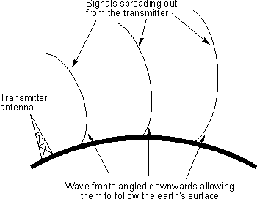
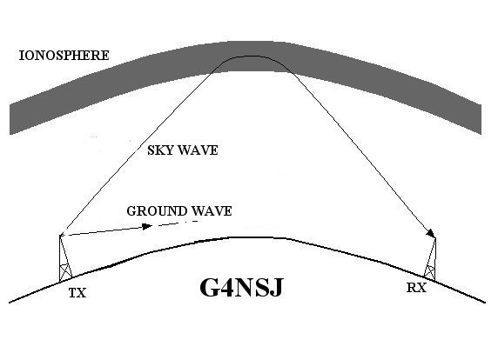
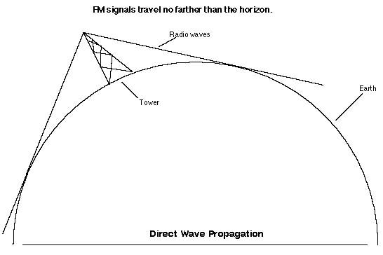
RADIO FREQUENCY PROPOGATION
Data is carried over electro-magnetic radiation in the form if radio waves.
Ground Wave
This follows the curvature of the Earth.
2. Ionospheric Propogation
This bounces off the Earth’s ionospheric layer in the upper atmosphere.
3. Line of Sight (LOS) Propogation
Transmits exactly in LOS.

Slide 9
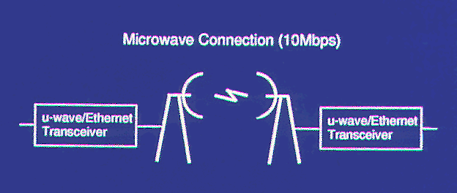
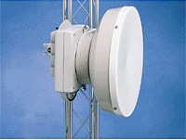
MICROWAVE LINK
For long distance communication, microwave radio transmission is widely used.
Parabolic antennas are mounted on towers to send a beam to another antenna, which could be tens of Kms. Away, but it should be in line of sight.
Microwave link use repeaters at intervals of about 25 to 30 km in between the transmitting and receiving stations.

Slide 10
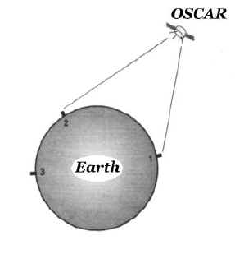
SATELLITE
The problem with microwave communication is LOS.
A communication satellite is an electrical device positioned in an orbit around the earth. It can be thought of a big microwave repeater in the sky. It contains one or more ‘Transponders’ each of which listens to some portion of the frequency spectrum, amplifies the incoming signal and then rebroadcasts it at another frequency. Different frequencies are used for ‘uplinking’ and ‘downlinking’ to avoid interference of signals.

Slide 11
INFRARED
Infrared (IR) is a form of light (or radiation) that is invisible to the human eye.
It is used for short range communication.
The remote controls used on televisions, VCRs, Stereos use infrared communication, indoor wireless LANs
Advantage
Directional, cheap, easy to build

Slide 12
Research/Practical Exercise:
Research the pin-out of a Crossover and a straight thru network cable(give diagrams)
Students get into groups to make and test a Crossover Cable and a straight thru cable.

